Slide 1

User Manual for Encryption and Decryption Tool
GESZER SHANE GUMAPAC
ZUJI AKIRO OMO

Slide 2
Introduction: The Encryption and Decryption Tool is designed to secure your data by encrypting it using various algorithms and decrypting it when needed. This user manual will guide you through the process.

Slide 3
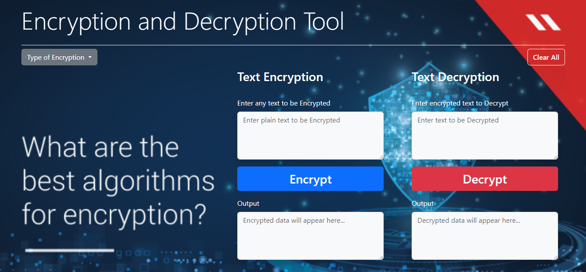
Software Interface:
Consist of option for text encryption and decryption.

Slide 4

How to use the software?

Slide 5
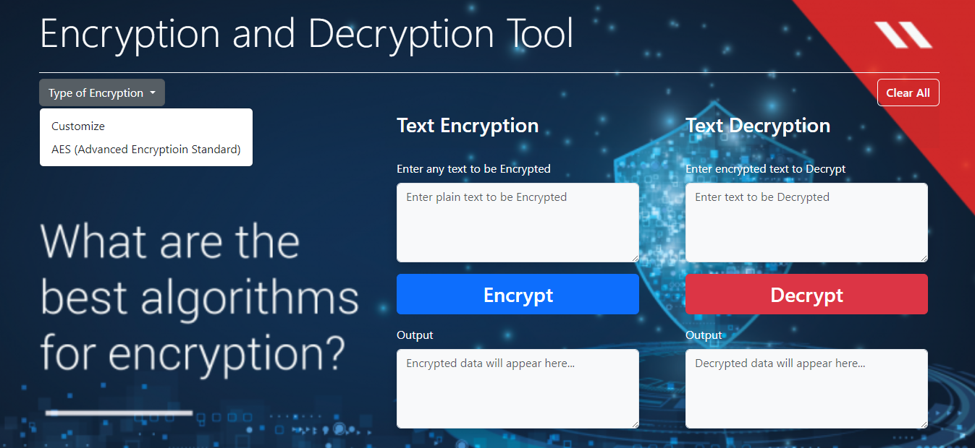
Type of Encryption:
Choose the type of encryption you want to use for securing your data.

Slide 6
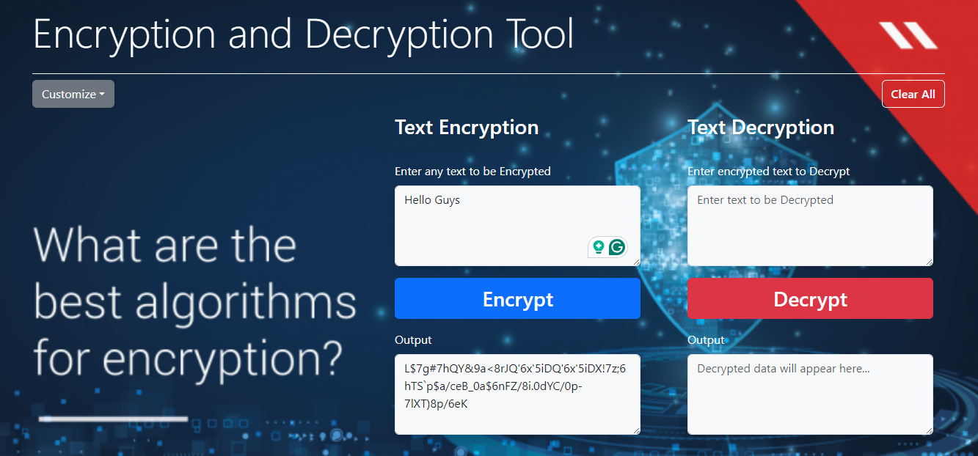
Text Encryption:
Enter Plain Text to be Encrypted: Input the text that you wish to encrypt into the designated text field.
Click on the “Encrypt” button to initiate the encryption process.
Output: The encrypted data will be displayed in the output field.
1
2
3

Slide 7
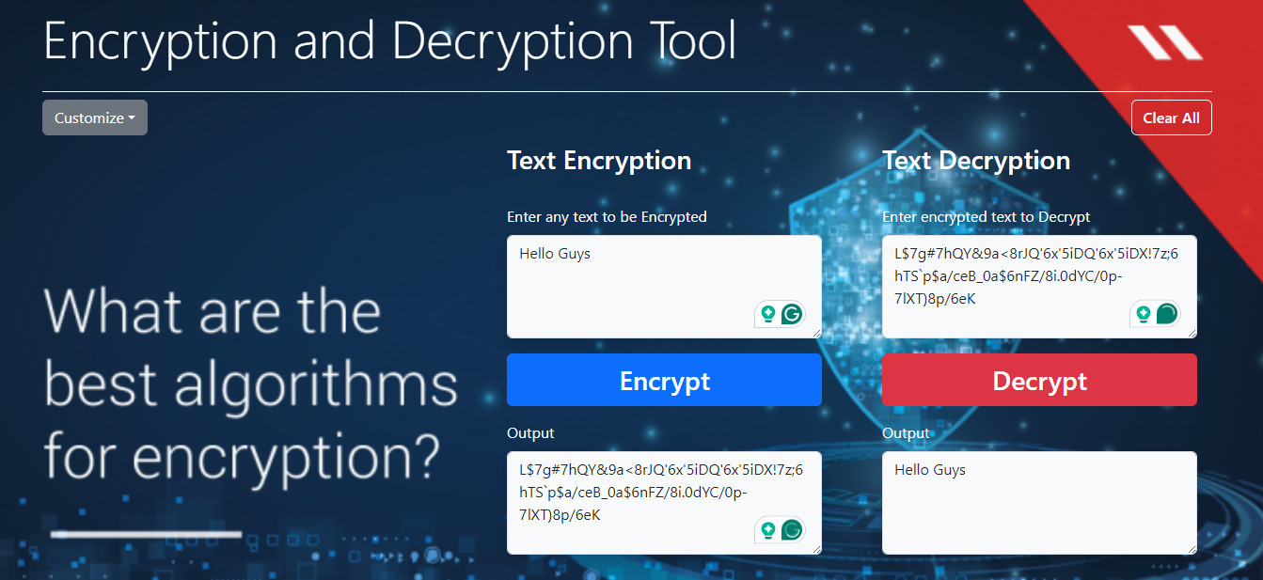
Text Decryption :
Enter Encrypted Text: Input the encrypted text that you want to decrypt into the designated text field.
Click on the “Decrypt” button to begin the decryption process.
Output: The decrypted data will be displayed in the output field.
1
2
3

Slide 8

Clear All: Clicking on this option will clear all text fields, allowing you to start fresh.

Slide 9


